Slide 1
Syd_dat_7 ”The Pain of Discovery”

Slide 2

The problem:
At the moment, our primary product is sold in strict networks – when you buy JCDecaux you buy 210 panels in Sydney with very little choice on where these panels are allocated
These days with programmatic selling of digital becoming the norm, and more of our inventory becoming digital, we are getting pressure to sell on audience rather than our current selling model

Slide 3

HELLO! Can I find a solution with the power of data science type stuff?
I thought that using some of our current insights sources (our GIS ’location intelligence’ tool) I may be able to understand how if we can still profit from changing our model of selling from random allocation to selling based on audience yields

Slide 4
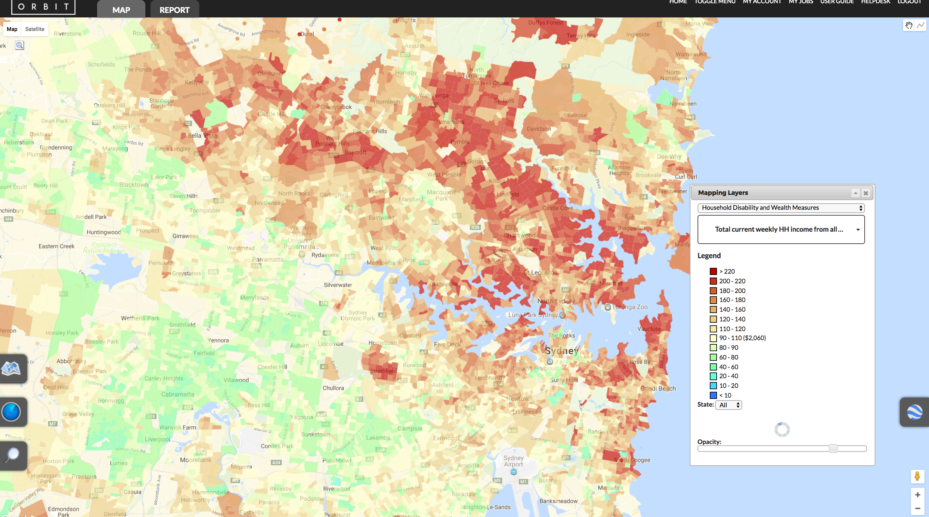
WE HAVE A GIS INTERFACE THAT DOES SOME SEXY MAPPING
Place your screenshot here
We use this to justify the reach of our assets to a range of different audiences, based on the individual needs of each campaign

Slide 5

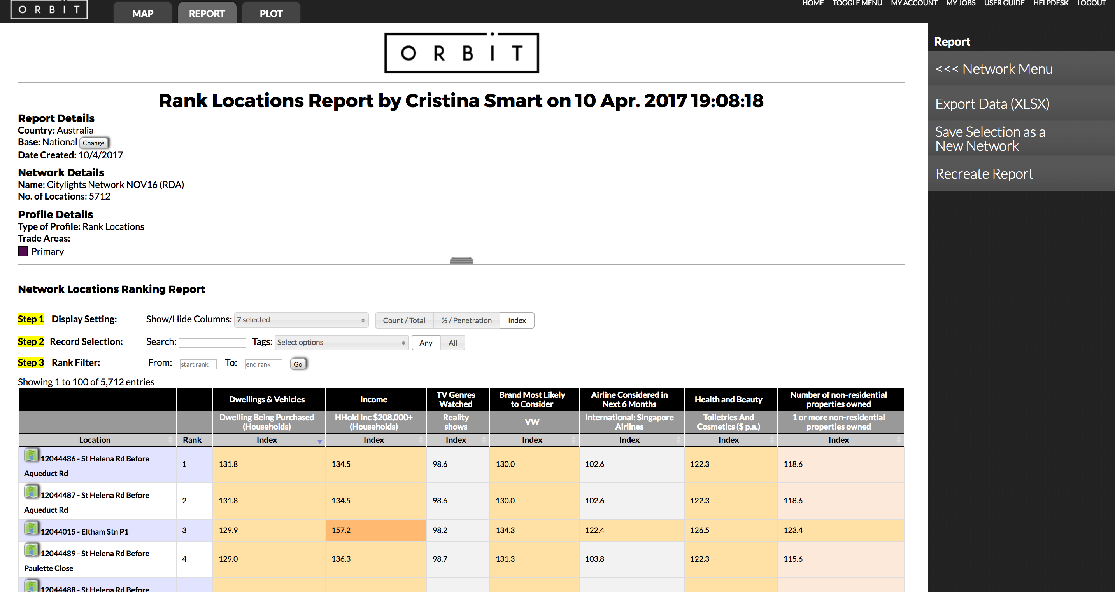
IT DOES SOME COOL REPORTING STUFF TOO
Place your screenshot here
At the moment, we may use it just to guarantee a skew of a network to reach a certain audience – say 20 out of the 210 panels will be out of this list.

Slide 6
Then I thought – what if we used the reports in our GIS to try to understand what would happen if we sold based on the audience yields for our clients?

Slide 7
SO I STARTED THINKING ABOUT HOW TO DO THIS WITH THE TOOLS WE’VE RECENTLY LEARNED
We’ve learned a range of ways to predict and cluster
We’ve also learned some coding so that we can do this all in one place
So I thought I’d start by looking at a week or two of our past bookings and see what would happen if we sold them based on their audiences…

Slide 8

I THOUGHT I WAS AMAZING FOR A MOMENT WHEN THINKING ABOUT THIS PROJECT
But that was before I actually started…

Slide 9

So let’s see some of that first stuff…

Slide 10
This was my approach at the start basically – just throwing mud and hoping it stuck!

Slide 11
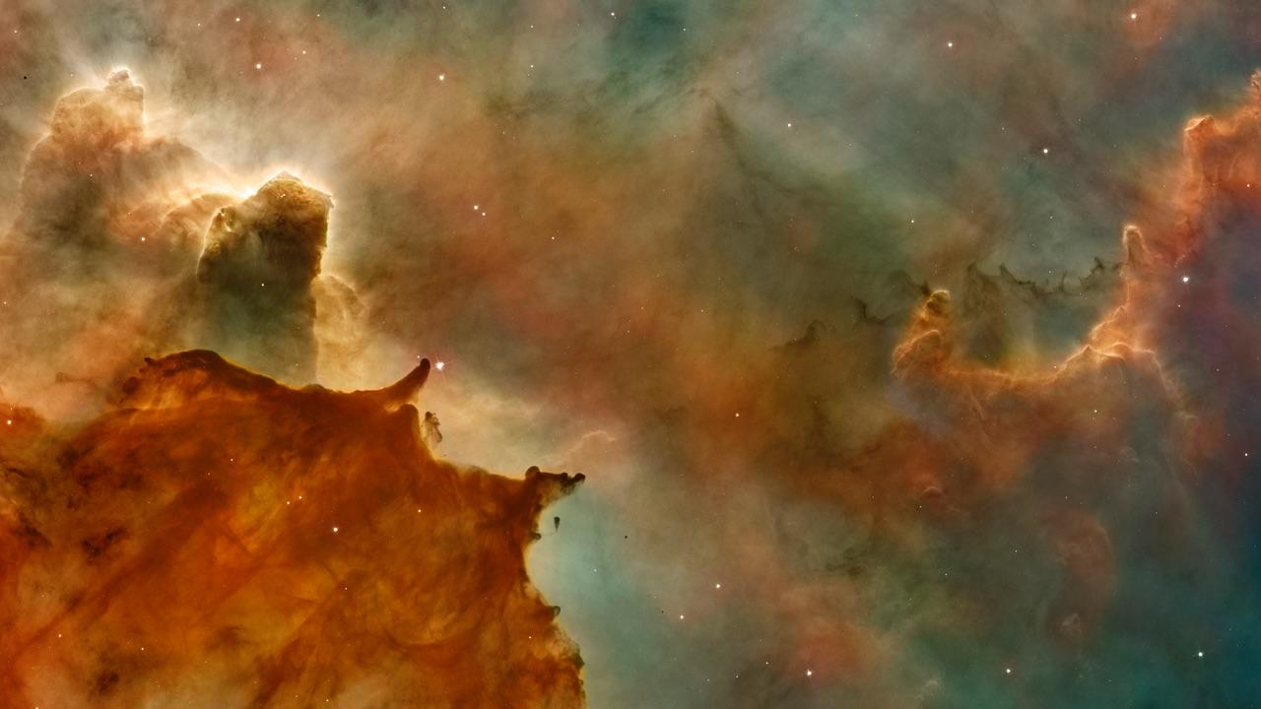
Then I had a breakthrough
I realised that I was trying to predict a NUMBER…

Slide 12
So in my mind it is
Audience
Price
Location
Simple… right?

Slide 13
WRONG
I was (and am) still bloody stuck, but I’ve done some more analysis in the meantime…

Slide 14

SUDDENLY IT ALL BECAME VERY CLEAR
How can I try to predict a price without any price set?
I have to COMPLETELY RETHINK THIS!

Slide 15
SO WHERE TO NEXT?
Ok, well there are many ways to skin a cat, but I will keep at it
And to be honest, I’m not quite sure, but my bet is actually creating a decision tree to classify set price TYPES then predict on that!
And lastly, I’m a little disappointed I didn’t get to do a BRUTEFORCE cos it sounds so cool…

